Slide 1
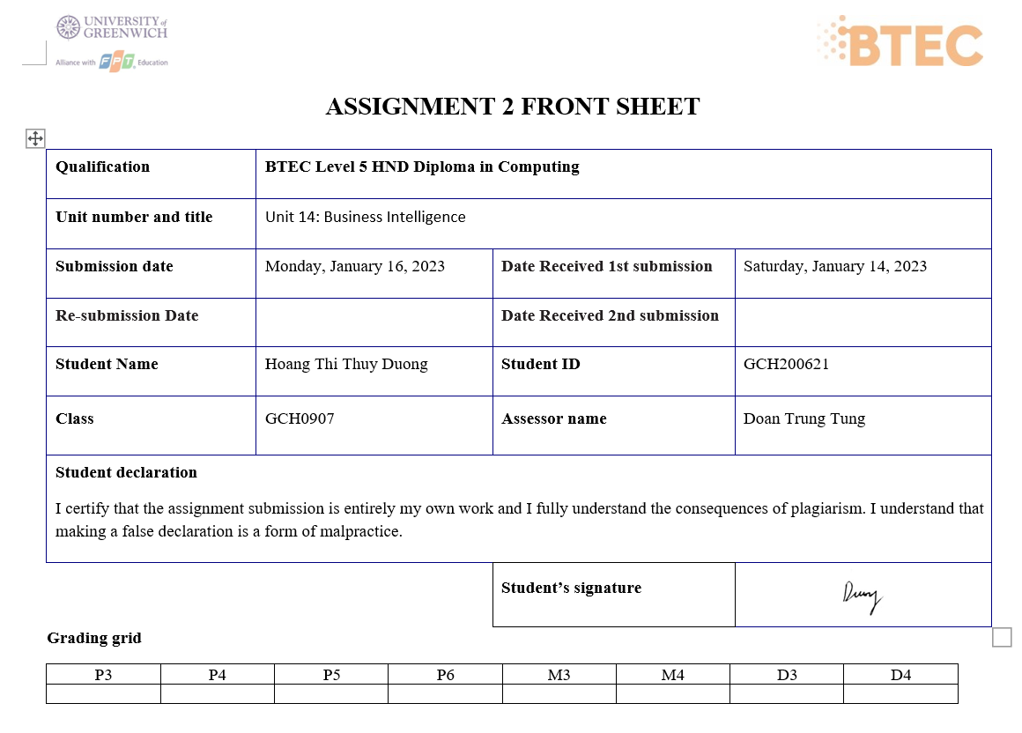

Slide 2
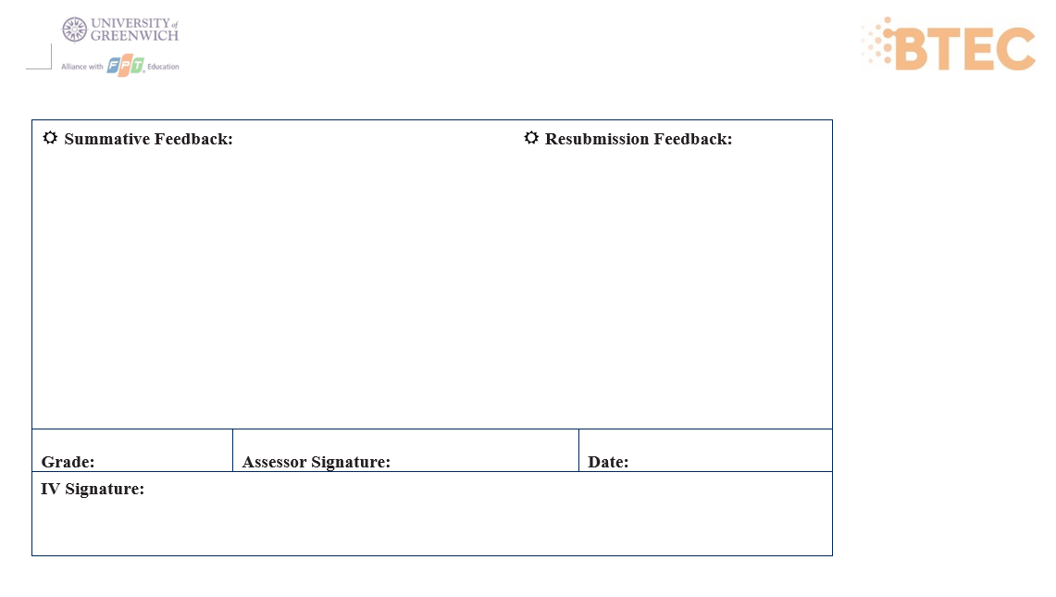

Slide 3
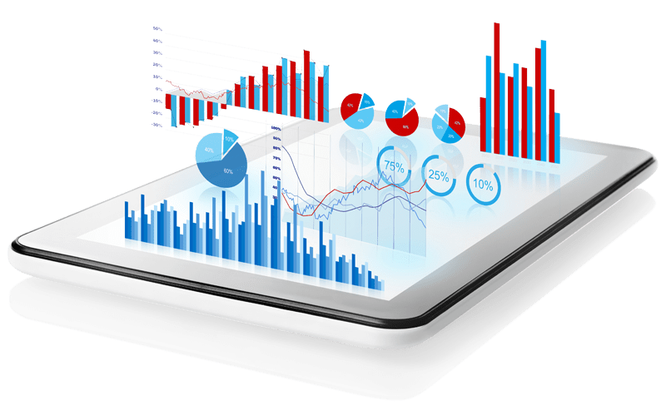
Bussiness Inteligence

Slide 4




Our team
Dang Q.Huy
Thuy Duong
Luu T.Minh
Nguyen Đ.Hung
Leader

Slide 5
Table of contents
01
02
03
General BI
Define, example, BI techniques, BI tool
Demonstration about BI
Chart, dashboard
Point of View
Point of view how business intelligence tool can contribute to effective decision-making

Slide 6
BI
01
Define, example, BI techniques, BI tools

Slide 7
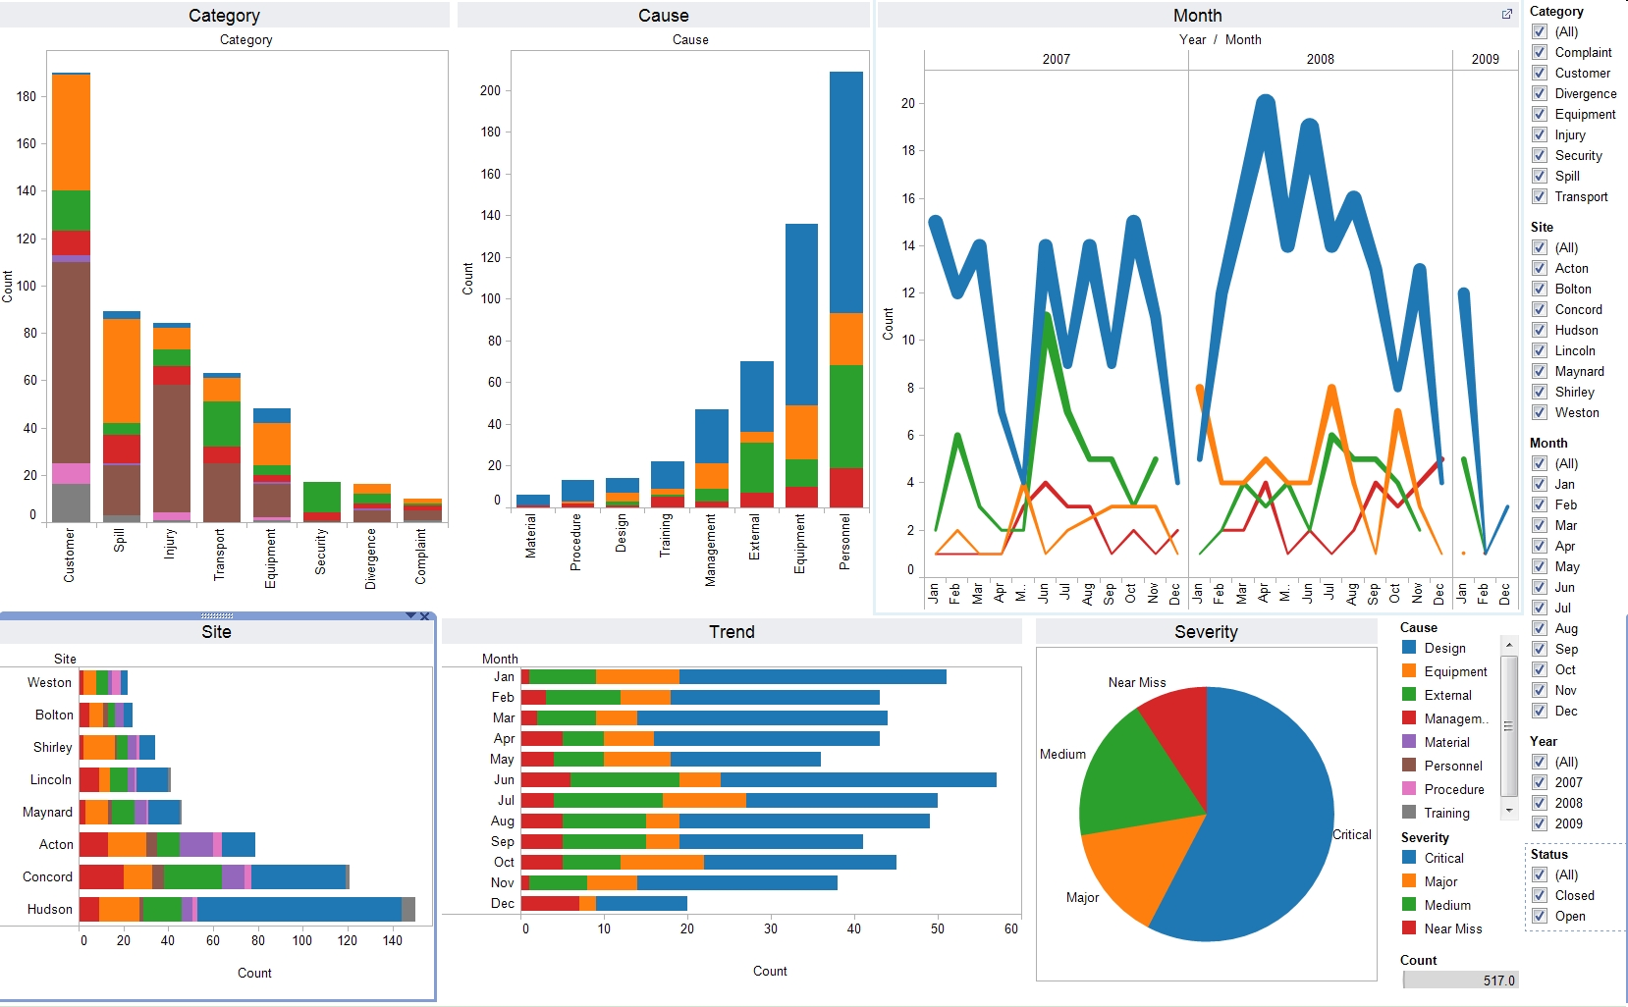
What is BI?
Utilizing software and services, business intelligence (BI) transforms data into insightful knowledge that affects a company's strategic and tactical business decisions. BI tools retrieve and analyze data sets in order to provide users with insights into the condition of the business. Analysis results are then shown as reports, summaries, dashboards, graphs, charts, and maps.

Slide 8
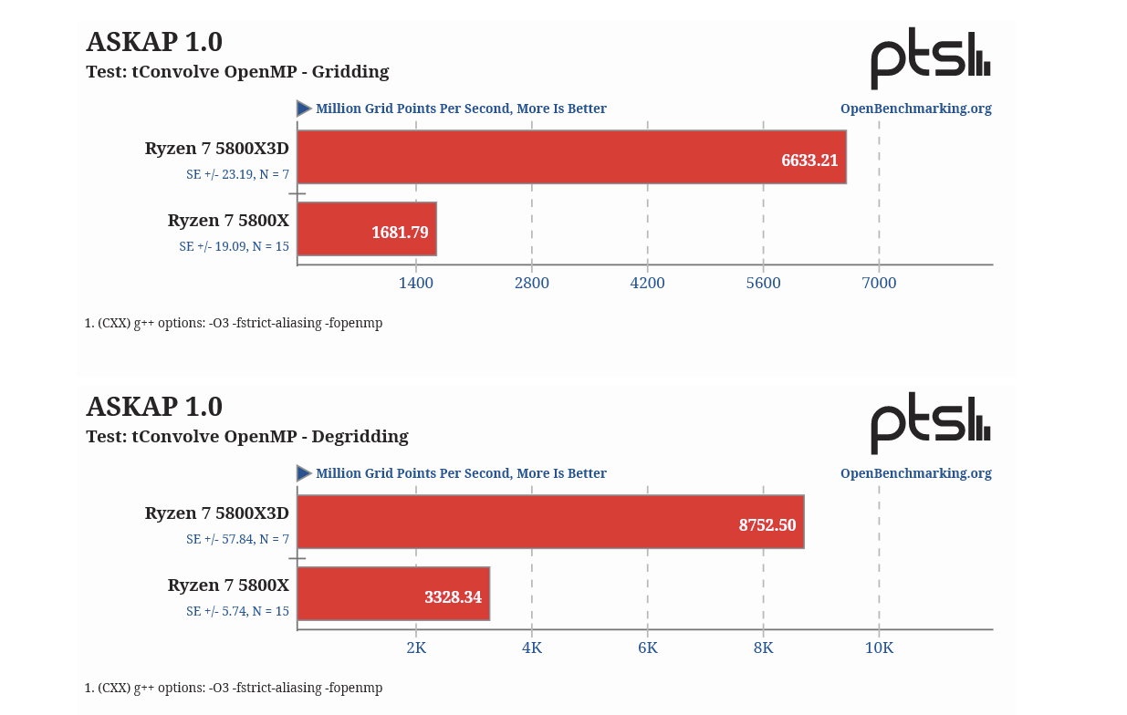
Real examples of how to apply BI on business
Reddit eliminates a data bottleneck
Reddit didn’t originally plan on everyone using their business intelligence tool, but because Chartio was so easy to use, they kept getting requests from employees to query data on their own. The end result was a culture of data democracy like DataRobot, but through a “grassroots” progression.
Once they gave access to the rest of the company, the sales team became some of the biggest BI enthusiasts, using it to analyze Reddit’s huge data set in real time to identify when brands or products got mentioned among the 2-million-plus communities. They use Chartio and Google BigQuery to create graphs and visualizations showing how brands can naturally enter the discussions happening every day on Reddit.
This kind of insight never would have happened if the bottleneck stayed in place. It also wouldn’t have happened without a culture of data democracy. As Justin Bassett, data scientist at Reddit, says: “More people are making discoveries and uncovering answers they couldn’t have found on their own before,” later adding, “Sales have increased dramatically.”

Slide 9

BI techniques:
1
2
3
Collection techniques
Analysis techniques
Analytic techniques
Cleansing, labeling…
Report, queries, dashboards..
Regression, machine learning

Slide 10

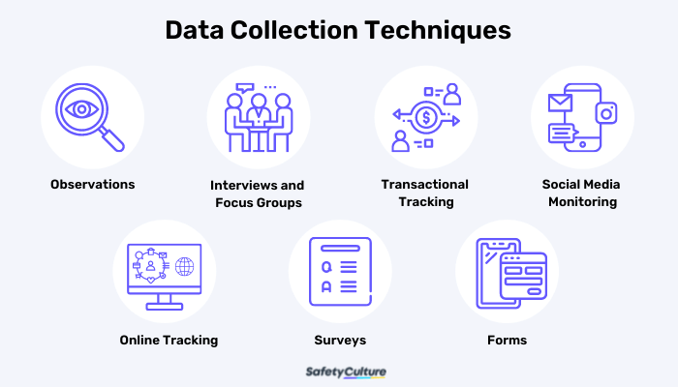
Collection techniques
It is applied at the beginning of analysis. Data-driven judgments require digitally recorded raw data that is pertinent and well-organized. Use in data such as basic customer data, historical stock price data, social media, financial trading data.

Slide 11
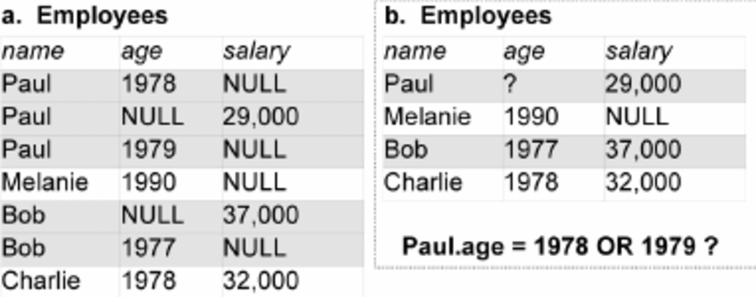
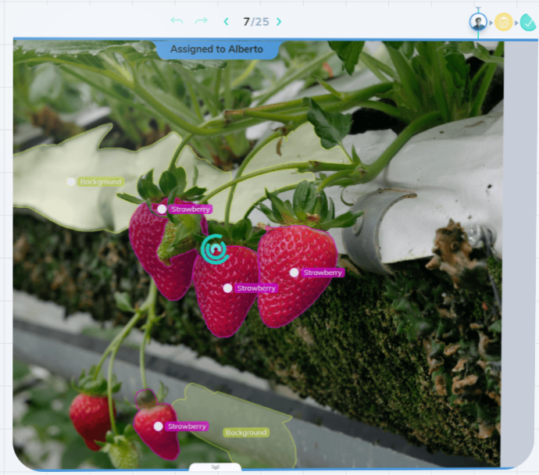
Collection techniques
Cleansing, dealing with missing values: Make sure that there aren’t any spelling mistakes or missing values that need to be corrected. These mistakes are usually human errors or someone that didn’t fully fill in forms.
Labeling: Refers to the process of adding tags or labels to raw data such as images, videos, text, and audio. These tags form a representation of the type of object the data belongs to.

Slide 12
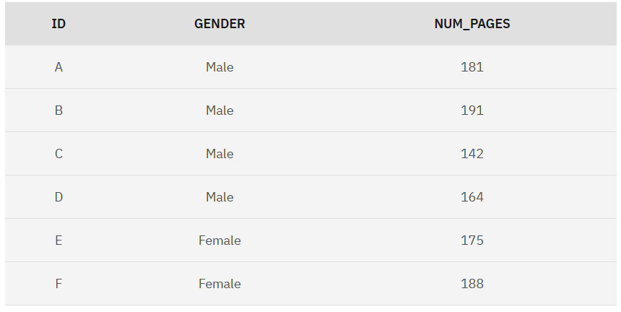
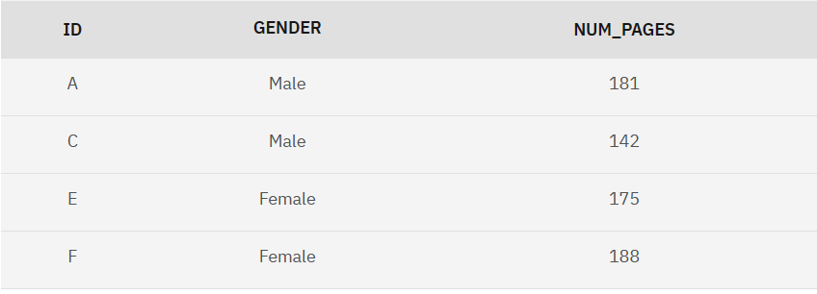
The original data set again has 4 males and 2 females. The data still has 2 males for every 1 female.
Balancing: A balanced dataset is a dataset where each output class (or target class) is represented by the same number of input samples.
In the balanced data set, the records with IDs B and D have been discarded from the data set. The data set now has an even distribution with 2 males and 2 females.

Slide 13
Analysis Techniques
It is used following the collection and organization of the data. In order to get business insights, reports and dashboards are created using data. It uses data for inventory management and pricing optimization.
Extract info and present it in the form of : metrics, KPIs, reports, dashboards.

Slide 14
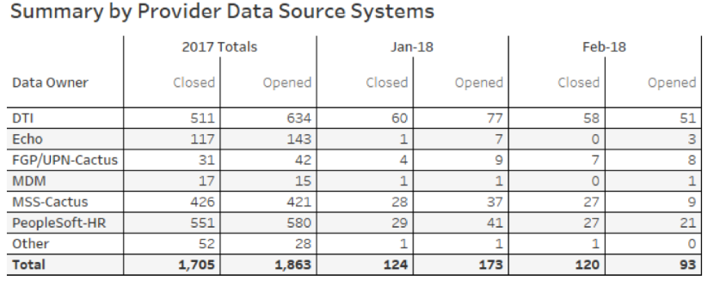
Example of Analysis Techniques
Metric table developed in Tableau demonstrating the total number of tickets opened and closed by source system, on a monthly basis.

Slide 15
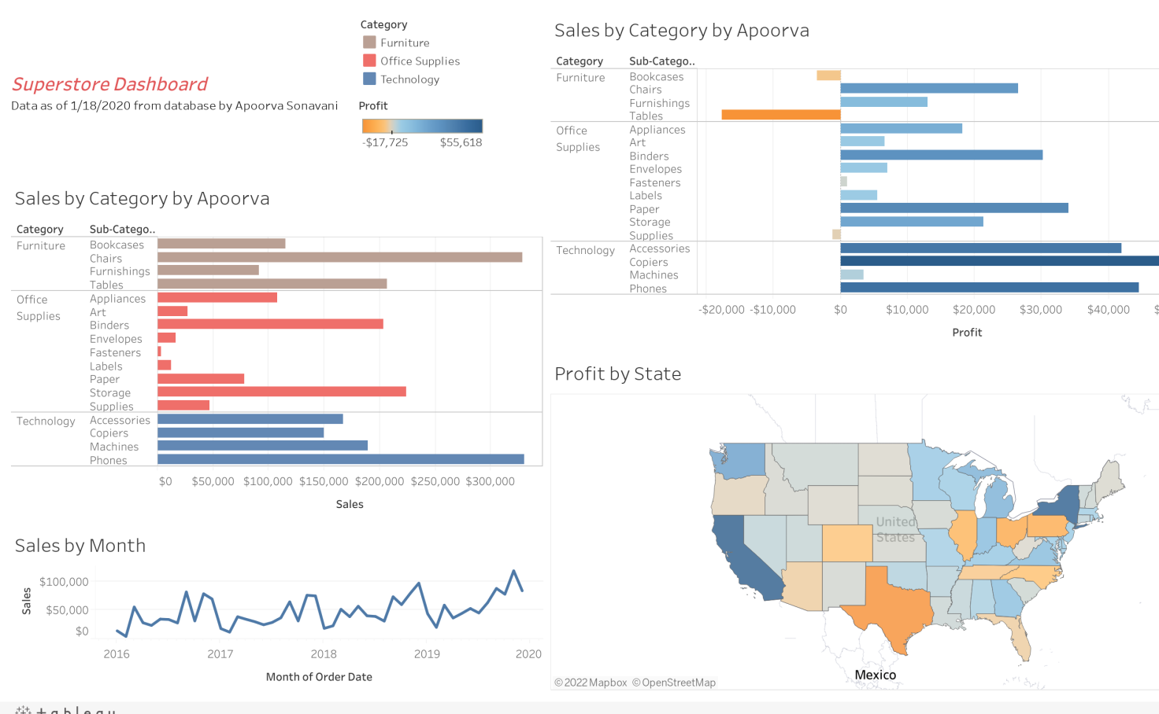
Example of Analysis Techniques
Superstore Dashboard

Slide 16
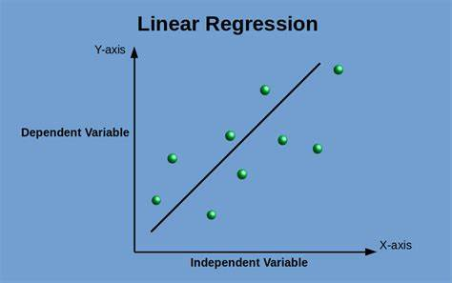
Analytic techniques
It is used following the creation and discussion of BI reports. Traditional approaches use sophisticated statistical techniques to evaluate probable future scenarios. Artificial intelligence is used in machine learning to anticipate behavior in novel ways.
Traditional methods:
Regression: Regression is a statistical method used in finance, investment, and other industries to determine the strength and character of the relationship between a dependent variable (often denoted Y) and a dependent variable. series of other variables (known as independent variables).

Slide 17
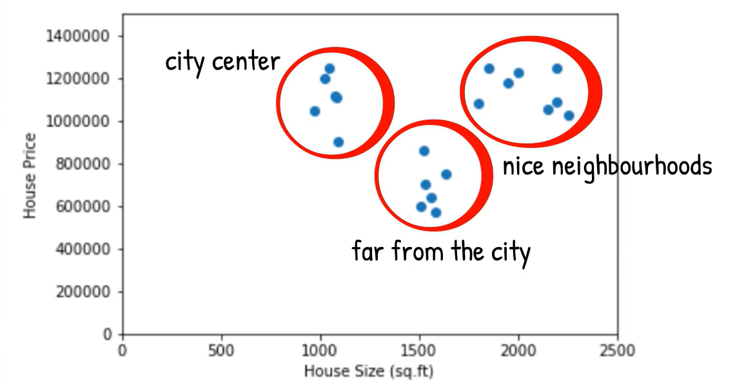
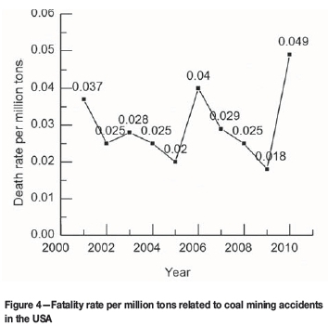
Analytic techniques
Clustering: Cluster analysis is the grouping of objects such that objects in the same cluster are more similar to each other than they are to objects in another cluster.
Time series: Time series analysis is a specific way of analyzing a sequence of data points collected over an interval of time.

Slide 18
Analytic techniques
2. Machine learning:
Supervised learning: Image and object recognition: Supervised learning algorithms can be used to locate, isolate, and classify objects out of video or images.
Unsupervised learning: Personalized recommendations.
Many of the personalized recommendations you receive online are based on unsupervised learning strategies. These personalized recommendations work by collecting data about your browsing, shopping and viewing habits. The AI then tries to identify patterns in your behavior.

Slide 19
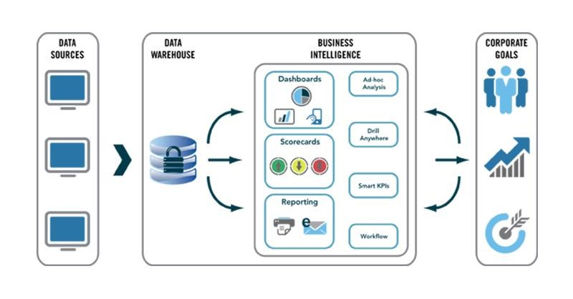
What is BI tool?
Business Intelligence (BI) refers to the technologies, processes, and skills needed to collect, analyze, and turn raw data into useful information.
Important features in these tools:
Dashboard
Visualization
Report
Data cleaning
ETL (tool to help import data from different data warehouses)
OLAP (online data analysis process)

Slide 20
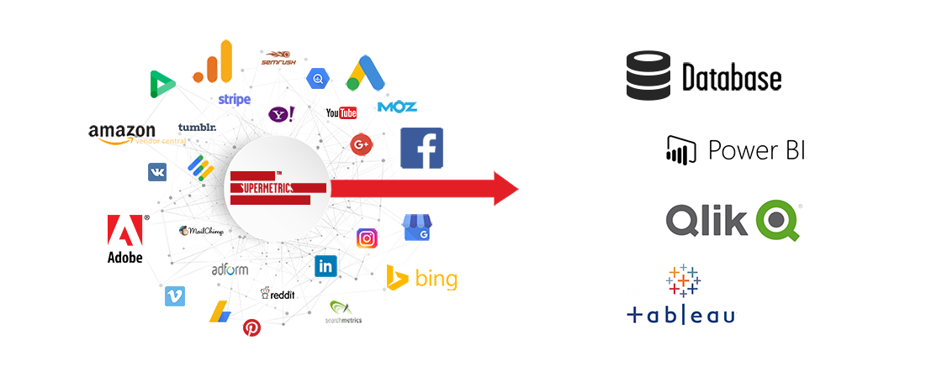
BI tools
Programming tools
Python, Visual Studio Code
Data visualization tools
Tableau, Power BI
Data warehouse tools
Excel, SQL

Slide 21
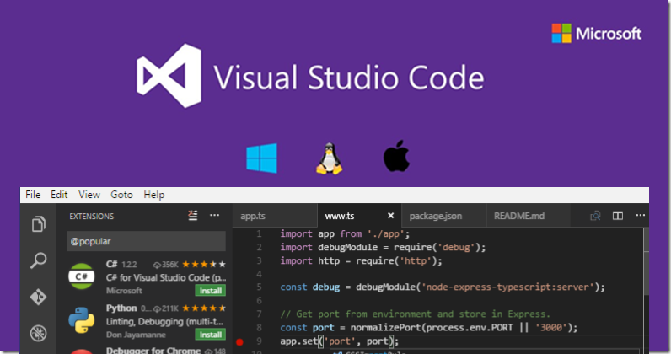

Programming tools (Python)
Python is a programming language widely used in web applications, software development, data science, and machine learning (ML). We use Python because it's efficient, easy to learn, and can be run on many different platforms. Python software is free to download, integrates well with all types of systems.

Slide 22
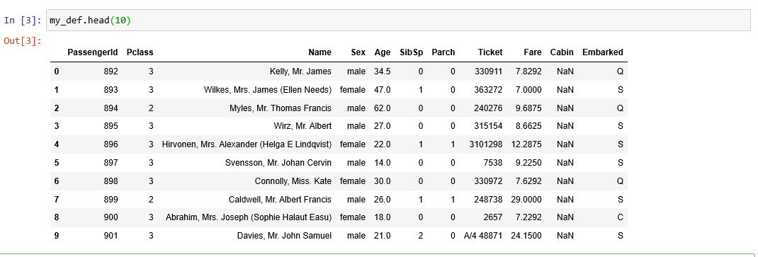
Programming tools (Python)
Some of the benefits of Python:
Python improves productivity because compared to other languages, they can use fewer lines of code to write a Python program.
Python has a large standard library that contains many lines of reusable code for almost any task. As a result, developers won't need to write code from scratch.
Developers can easily use Python with other popular programming languages like Java, C, and C++.
Python can be used on many different computer operating systems, such as Windows, macOS, Linux, and Unix.

Slide 23
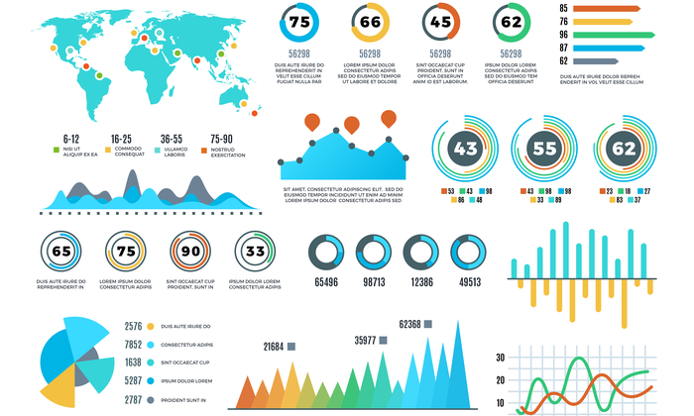
Data visualization tool?

Slide 24
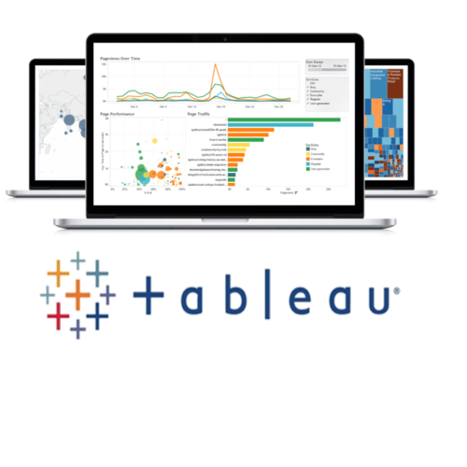
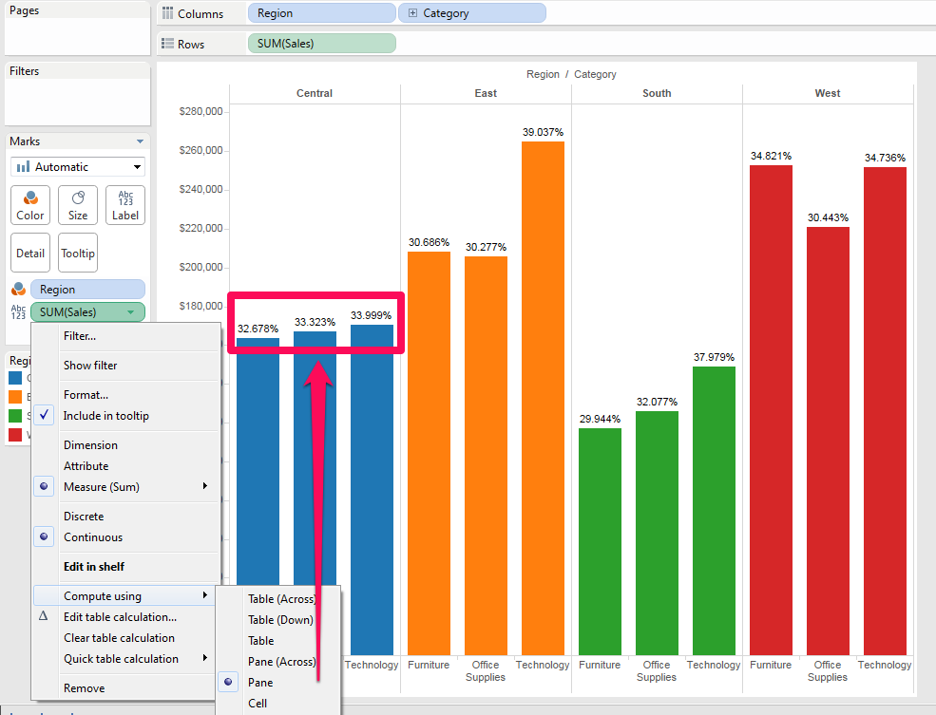
Tableau
As the market-leading choice for modern business intelligence, the Tableau platform is known for taking any kind of data from almost any system, and turning it into actionable insights with speed and ease. It's as simple as dragging and dropping.
Supports multiple data sources (Execl,csv, txt, Json, pdf, mdb)
Powerful data visualization capabilitiesUsing unique visualization technology, Tableau can quickly analyze data by presenting analysis results in a variety of colors, shapes, and sizes.

Slide 25
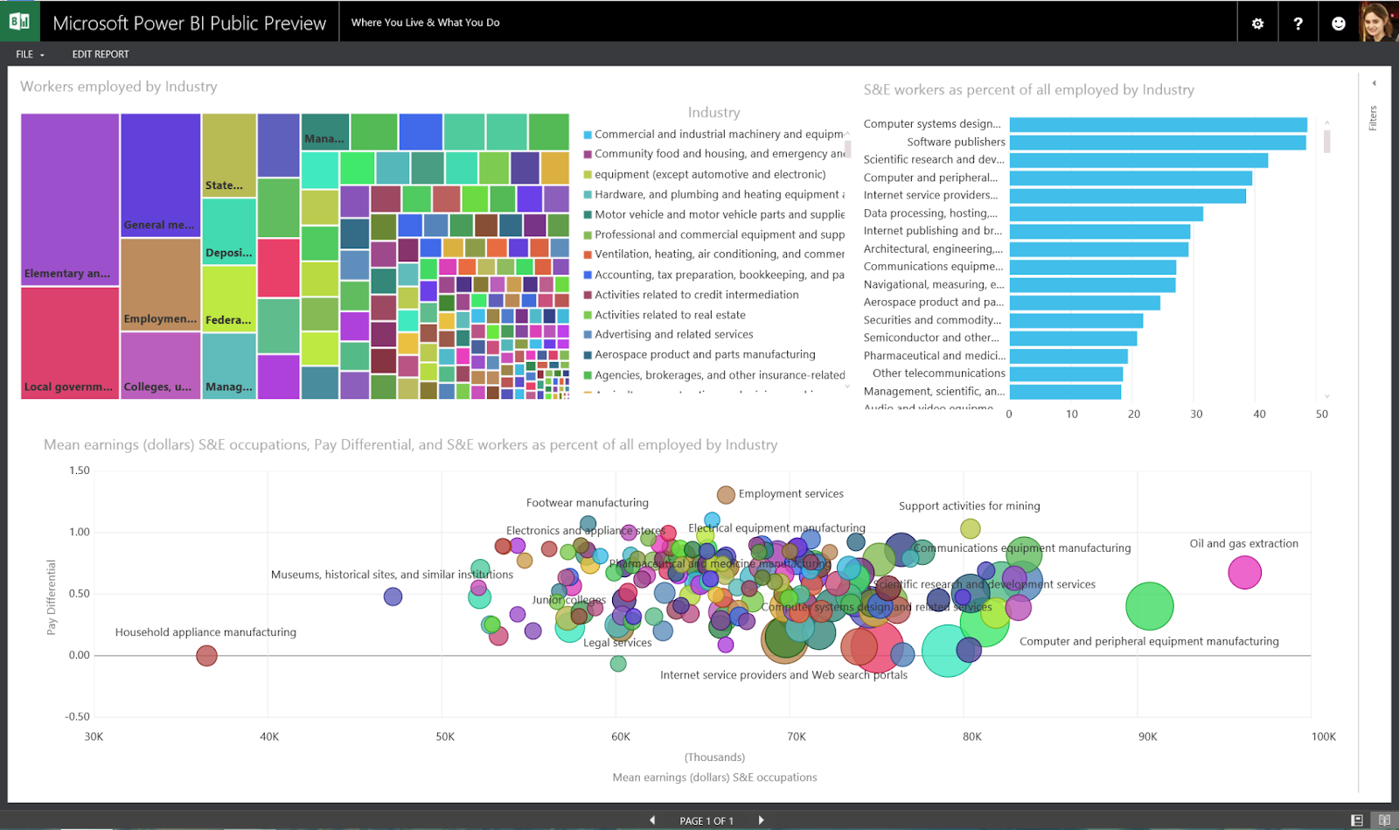
Power BI
Power BI is an interactive data visualization software product developed by Microsoft with a primary focus on business intelligence. Power BI is a collection of software services, applications, and connectors that work together to turn unrelated data sources into coherent, intuitive, and interactive insights. Data can be imported by reading directly from a database, a web page, or a structured file such as a spreadsheet, CSV, XML, and JSON.

Slide 26
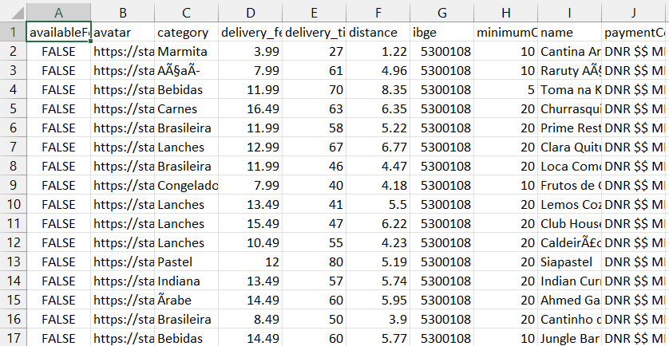
Data warehouse tools (Exel)
A spreadsheet tool called Microsoft Excel is part of the Microsoft Office software package and was created to assist with recording, presenting processed data in tabular form, doing computations, and creating statistical visualizations for tables created in Excel.
For instance, it is employed in operational management, performance reporting, human resource management, and business analysis.

Slide 27
Demonstration about BI
02

Slide 28
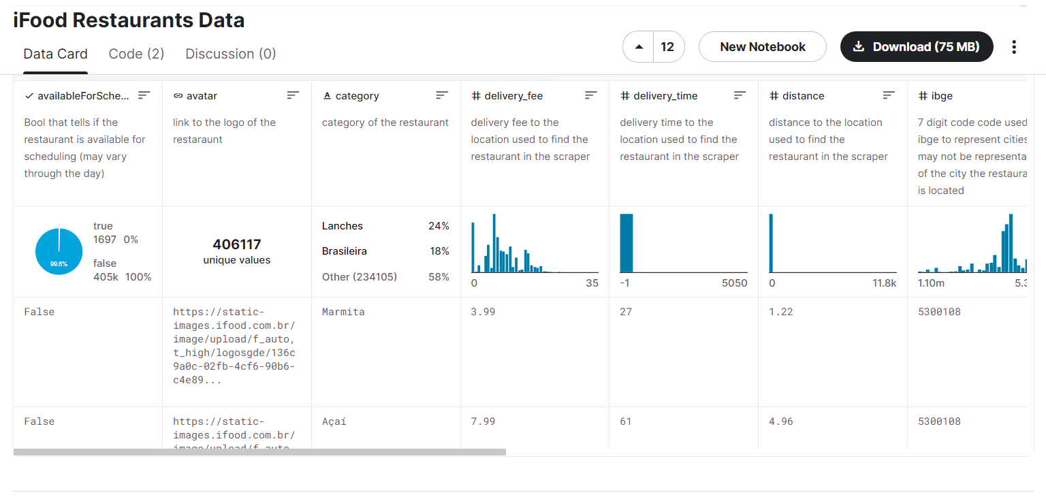
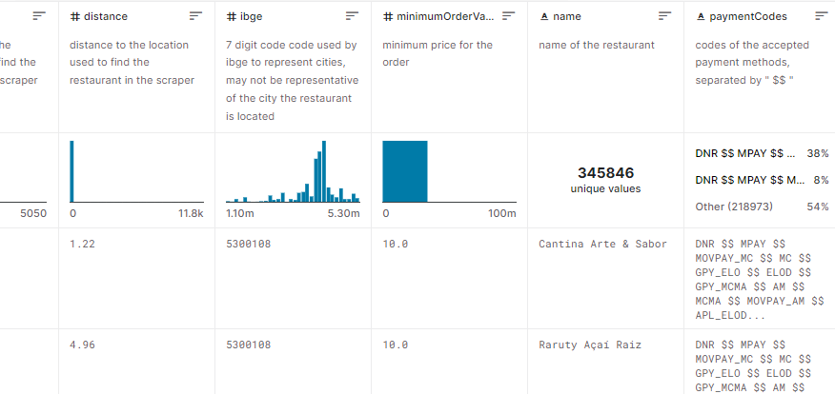
Dataset of Restaurant
The dataset contains data about all the restaurants in iFood as of February 27, 2021.
The data shows the number of restaurants at the IFood website and more restaurant-related information

Slide 29
Column in dataset
available for scheduling: Bool that tells if the restaurant is available for scheduling (may vary through the day)
avatar: link to the logo of the restaraunt
delivery_fee: delivery fee to the location used to find the restaurant
delivery_time: delivery time to the location used to find the restaurant
distance: distance to the location used to find the restaurant
Ibge: 7 digit code code used by ibge to represent cities, may not be representative of the city the restaurant is located
minimumOrderValue: minimum price for the order
name: name of the restaurant
payment codes: codes of the accepted payment methods
price_range: price range set by the restaurant (usually not representative of the reality)
rating: restaurant rating on the app (max of 5). 0 is probably an new restaurant
tags: Tags attributed to the restaurant by iFood. Used to promote the restaurant in the homepage

Slide 30
Code to clean data
Requests for correction
Avatar column: remove
Available column: remove for scheduling
Payment codes: change $$ to ,
Price Range: exchange cheapest, cheap,.... --> 1,2,3
Tag: Convert $$ to , uppercase--> lowercase , sign _ --> becomes space
Url column: Delete
Convert rating column to int type
Add column total number of payment methods
Count how many Tags

Slide 31
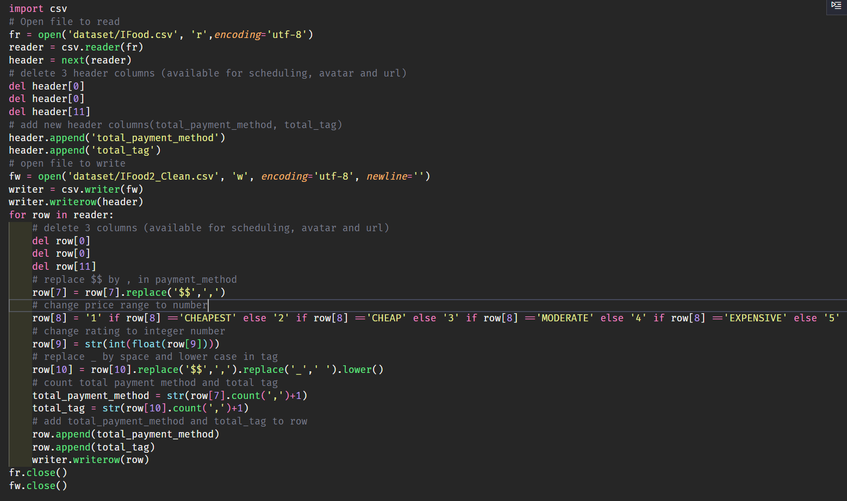
Code to clean data
Code to clean data

Slide 32
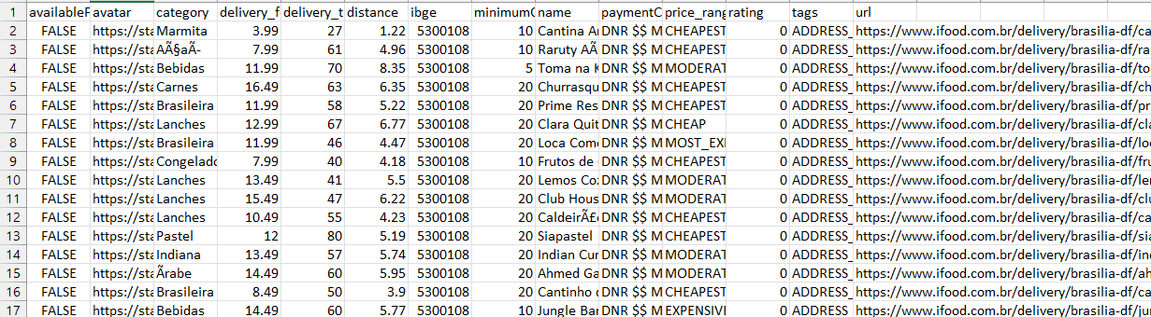
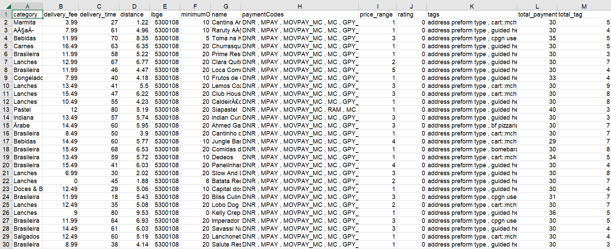
Code to clean data
The result:
Before
After

Slide 33
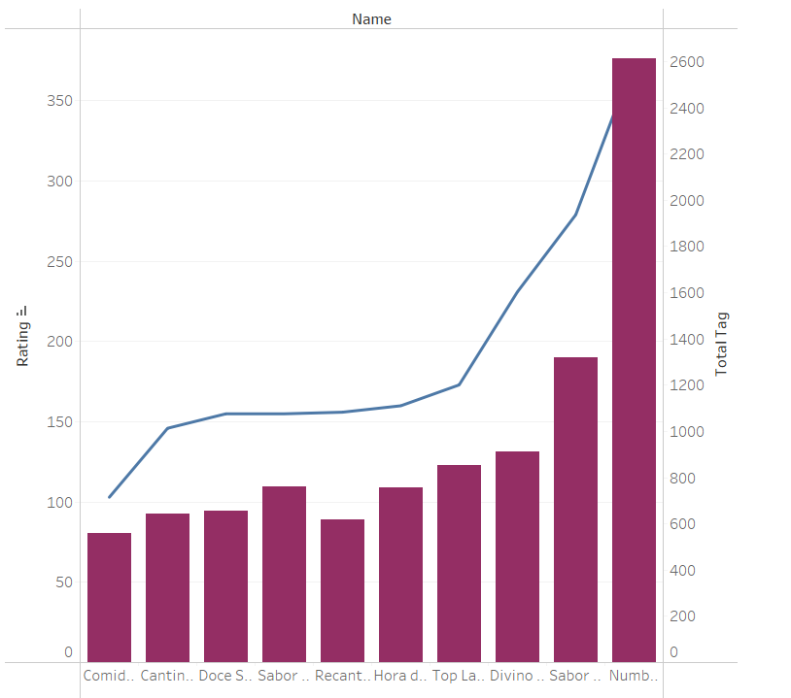
Chart rating and total tag of restaurants
The graph depicts the relationship between the restaurant's customer reviews and its advertising strategy.
The graphic shows that the level of advertising at the restaurants is still high compared to the level of customer reviews. However, they are proportional to each other. As a result, advertising has a significant impact on the store. However, the advertising has not been as effective as it could have been. Restaurants must review and enhance their advertising content, as well as their service and food quality, in order to attract more customers, after which they will receive more feedback in order to improve consumer feedback to everyone else.

Slide 34
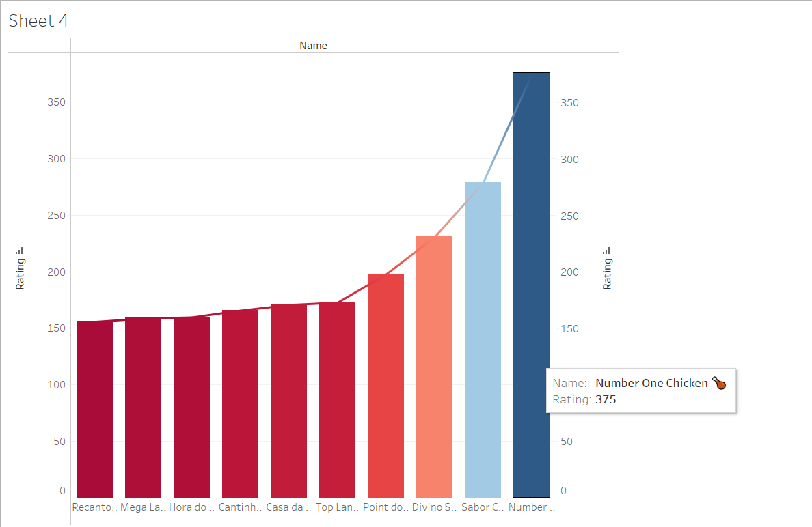
Chart rating of restaurants
The chart displays the top ten restaurants based on app ratings. According to the chart, the highest rating of "Number One Chicken" restaurant is 375. As a result, this may be a restaurant with numerous wonderful food, a fashionable atmosphere, and excellent customer service.

Slide 35
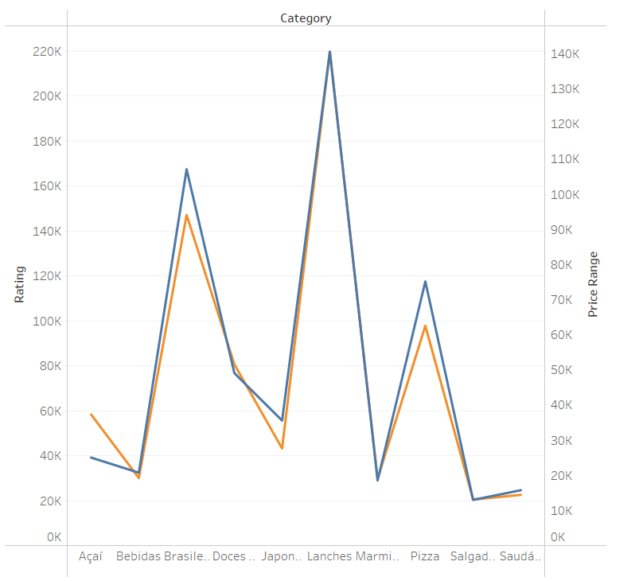
Chart rating and Price Range of restaurants
The chart displays the top ten most highly rated foods in the highest price range. According to the chart, Lanches has the highest quality rating and the highest price range. This is a trendy, delicious, and high-quality dish. Despite its expensive price, it is nevertheless popular among many individuals. Salgad obtained the lowest rating of 10/100 when compared to Lanches. Surely, the dish requires a fresh approach to develop more.

Slide 36
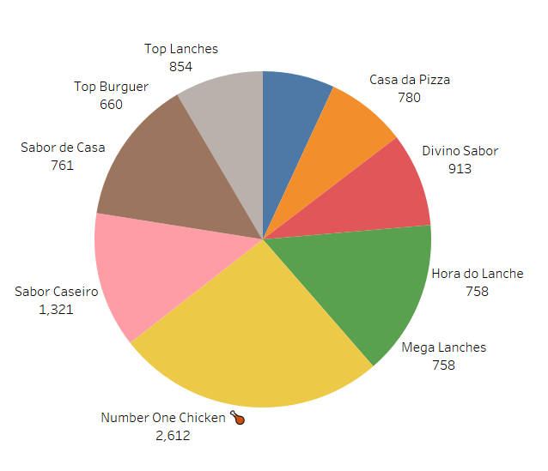
Name and tags of restaurant
The chart shows the top 10 restaurants tagged by IFood the most to develop ads.
The tags assigned by iFood to the restaurant. Used to promote the restaurant on the homepage.Based on the chart:Number one Chicken restaurant is assigned the maximum total number of tags(2612) tags.
This shows 2 possibilities:
Restaurants pay a lot of attention to advertising, promoting the restaurant's image.
2. Restaurant are highly recommended by IFood to attach many tags.

Slide 37
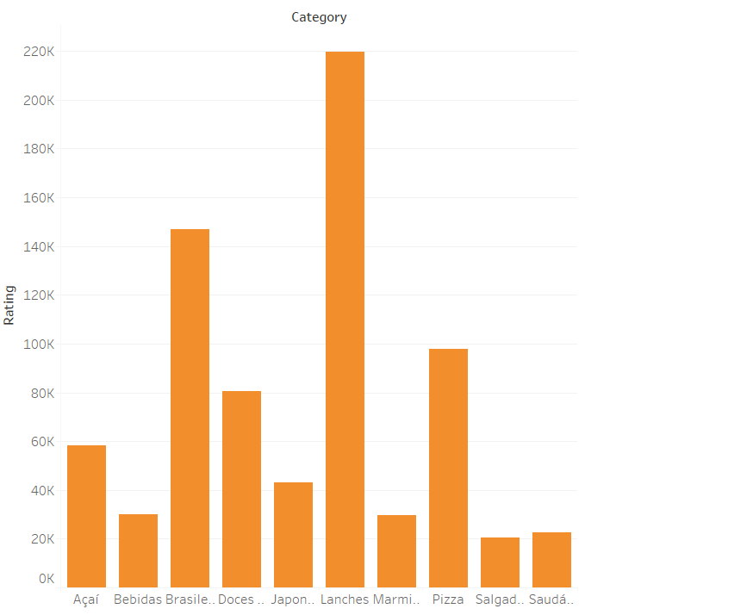
Category and Rating
Category and ratingThe chart shows the top 10 most appreciated dishes
Based on the chart:
Lanches dc are highly appreciated by customers. Therefore, this may be the most popular dish on IFood.

Slide 38
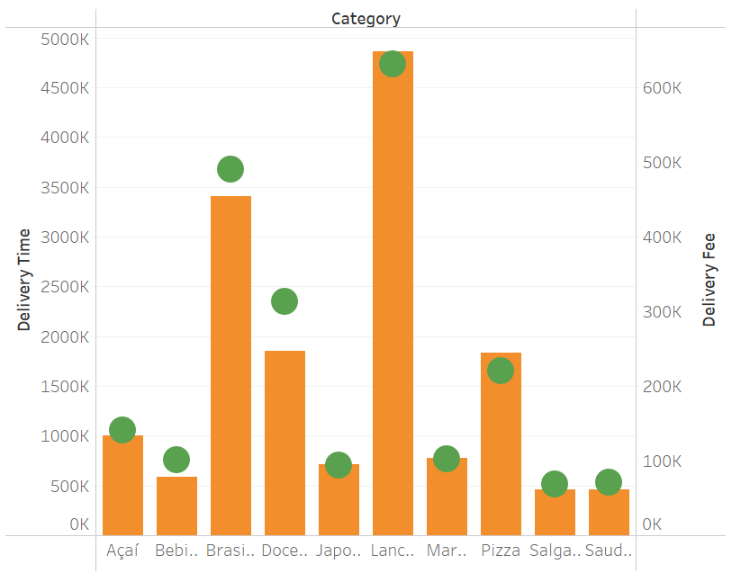
Chart about delivery of restaurants
Based on the chart, it can be seen that Lanches is the type with the most deliveries with 4,861,188 times, from which it can be seen that it may be the type of food that people love the most. The second highest is Brasileira with 3,409,589 deliveries. The remaining types of dishes have a lot less delivery times than the above 4 types of dishes. Lanches have the highest total delivery charges, which can be easily inferred because Lanches have the most deliveries. Based on the graph of the relationship between the number of deliveries and the cost of delivery, infer Two types of dishes, Brasileira and Doces & Bolos, earn higher delivery fees, possibly profit compared to the number of deliveries for the two dishes. 2 types of dishes, Lanches and Pizza, have a lower delivery fee, which can be a loss compared to the number of deliveries of the two dishes. The rest of the dishes have a delivery fee equivalent to the number of deliveries, revenue can break even for shipping. FROM that, it is necessary to adjust the delivery fee for Lanches, Pizza is the most popular dish in the top 10, to ensure that the shipping cost is not too low to affect other costs to produce the dish eat.

Slide 39
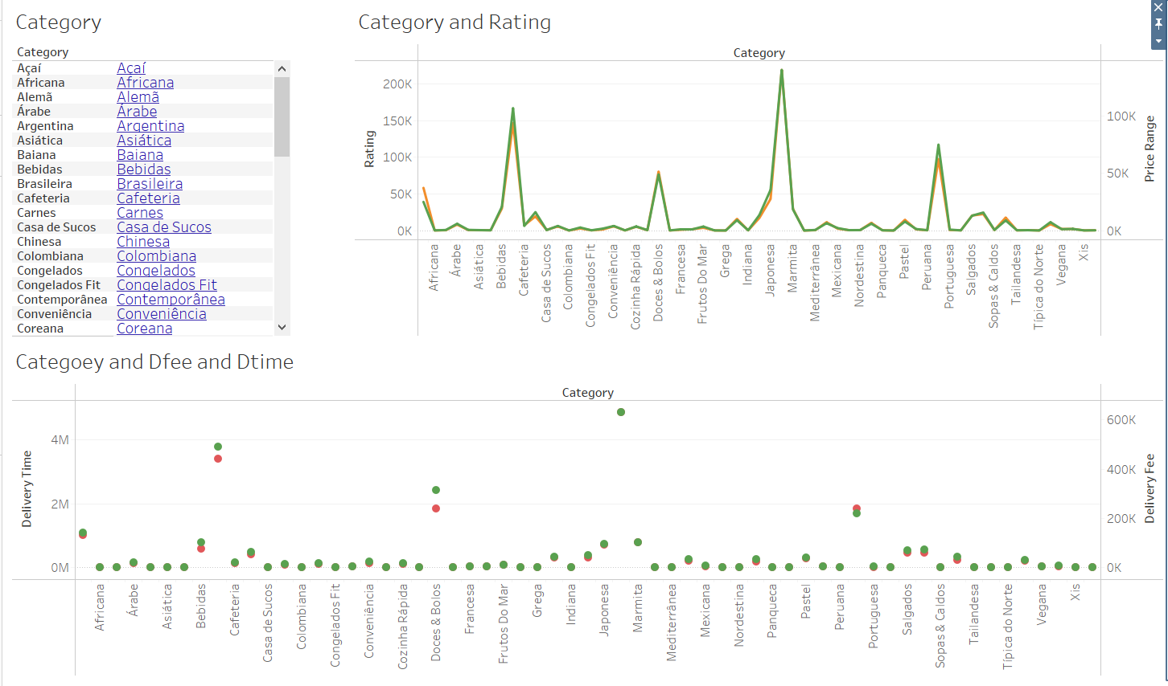

Slide 40
Explain dashboard
This dashboard includes 3 charts:
Category
Category and Rating
Category Fee and Time
The chart is broken down into restaurant categories. Data between app reviews and dish cost reviews should be visualized.Visualization of deliveries and overall delivery expenses Bebidas, Doces & Bolos, Japonesa, Peruana, and Portuguesa are examples of highly ranked cuisine. The foods are all expensive, but many people love the delivery service. Increasing the restaurant's revenue.
It's quite modest in comparison to the rest of the dishes. To promote additional business processes, the processes must be reviewed and improved.

Slide 41
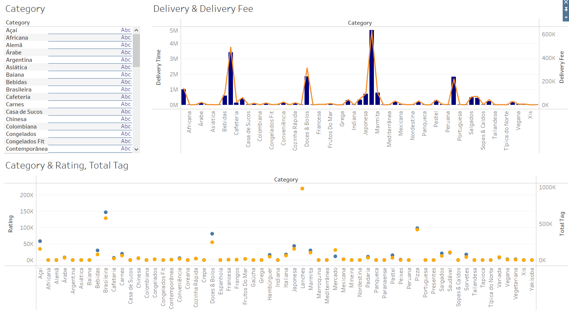
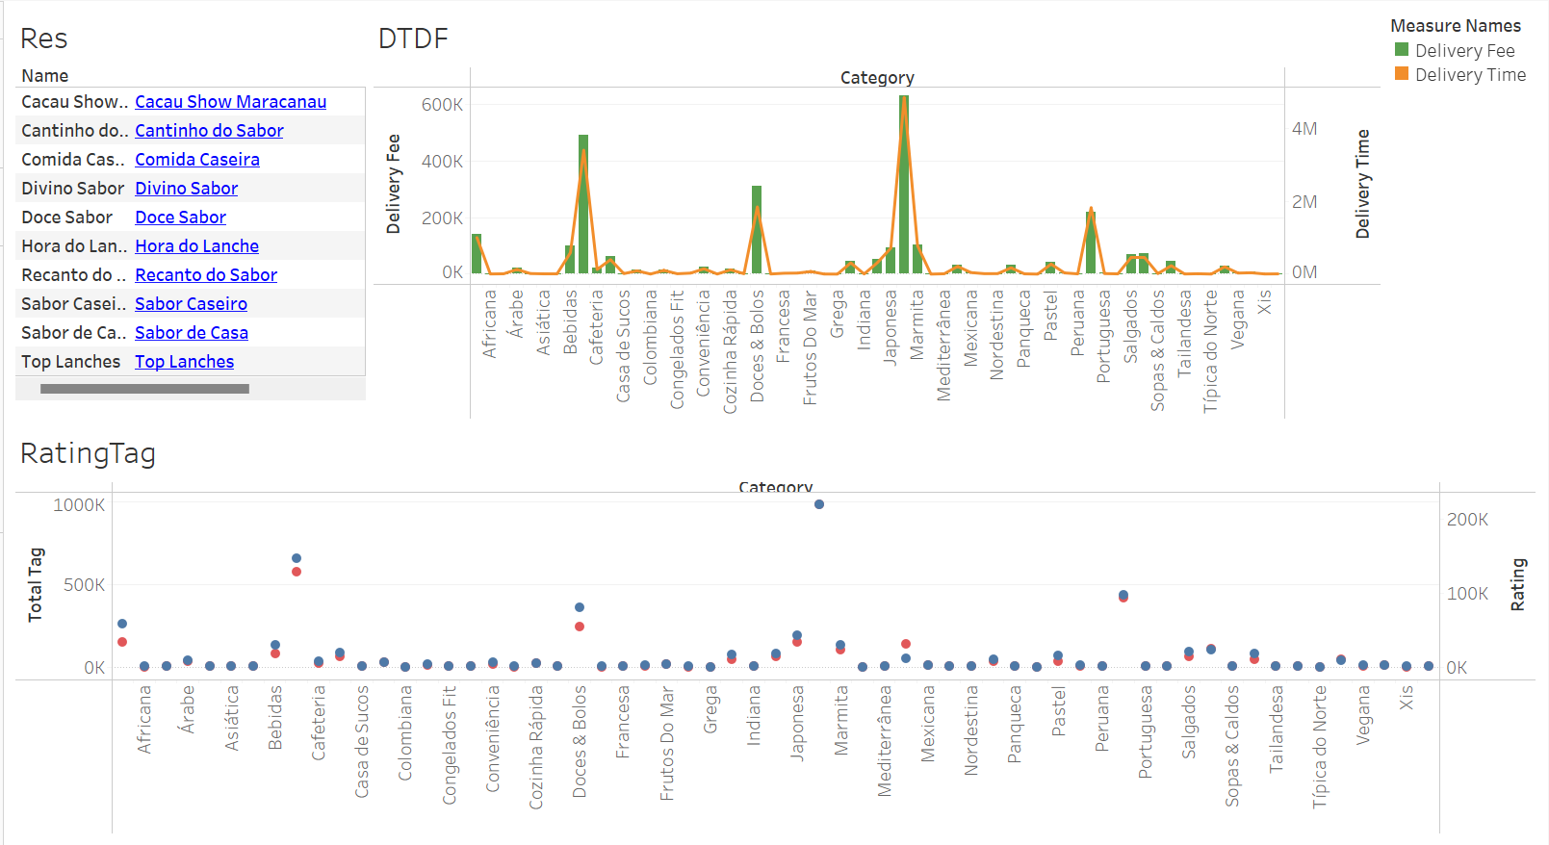

Slide 42
Explain dashboard
This dashboard includes 3 charts:
Restaurant Name
Category with Delivery Time and Delivery Fee
Category with Rating and Total tag
The graph shows the sales and rating of the dishes of all the restaurants. Based on the overall chart, it is possible to infer the top types of dishes with the most total delivery costs as well as deliveries such as Lanches, Pizza, Doces & Bolos. Along with the chart of the evaluation as well as the advertising of the dishes, the dishes just mentioned also have a high number of reviews and run ads in the top. Thus, it can be concluded that these dishes are the best sellers, loved by customers in restaurants. In addition, when clicking on each restaurant, you can see the evaluation data corresponding to the types of dishes of that restaurant, which can help restaurant managers come up with business strategies, boost sales for each restaurant. specific restaurant.

Slide 43
03
Point of View

Slide 44
How business intelligence tools can contribute to effective decision-making-
Enterprise data gaps may be found through BI. Through it, we are able to reprocess the data and assess the work that has to be done for the company.
BI actively supports the way our business is run while also assisting in cost and uptime optimization.
The analysis and prediction of BI helps businesses understand customer behavior. Through that, we can make appropriate decisions to attract customers and increase revenue for the company.
For example, we use tableau to find out which dishes and services are most used in a restaurant

Slide 45
Evaluate how they can use BI tools for extend their target audience and make them more competitive within the market.
After researching and analyzing data from tableau, we get detailed information about the most used products and services in restaurants such as price, quality, customer feedback about the restaurant. food, thereby focusing on improving the maximum quality, using discount programs for that food to attract more customers.

Slide 46

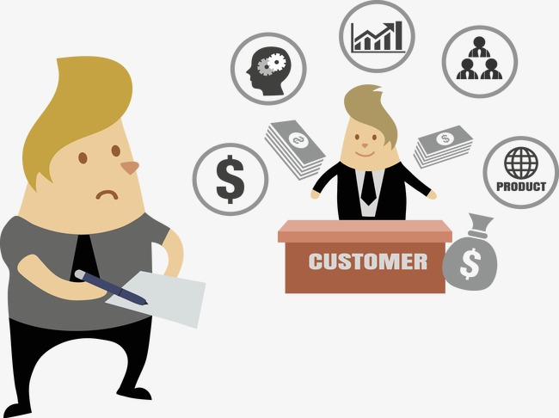
Legal Issues
1. Customer information:
Collection of personal information is to create a database to collect personal information of customers at the store. Personal information of customers includes name, age, date of birth, email, gender, home address, phone number, information about personal payment transactions.

Slide 47
Purpose of use information
Get information to deliver food to customers
The collected personal information will be stored and managed by the restaurant to meet the needs of customers in the transaction.
Customers can book a table in advance
Customers can pay online every time they dine and leave transaction information for the store to confirm the information.
Used to accumulate points and provide services to customers through discounts and promotions.
Restaurants can easily approach old customers by exploiting existing customer data, improving and adjusting services appropriately, thereby expanding market share.
Create food customer surveys

Slide 48
Legal policies used by the restaurant
Clearly and publicly inform customers about the purpose of collecting and using customer information before performing these activities
Use the information for the right purposes as notified to the customer and agreed by the customer.
Ensure safety, security, accuracy in the collection process
The restaurant will not provide or share customer's personal information to third parties, unless requested by a competent authority or with the consent of that customer.

Slide 49
Rate team members
Huy: Process and clean data files of datasets in Python, draw chart rating and price range of restaurants with explanations, draw dashboards on relationships between elements and categories with explanations, manage progress and controls. distribute work to members.
Hung: General concept of BI, examples of applying BI to business, concepts of BI tools, drawing chart name and tags of restaurant with explanation, drawing dashboard the relationship between elements and categories , BI tools contribute to decision making and broaden the target audience.
Duong: BI techniques also with real examples, some examples of BI tools, draw chart rating of category and chart about delivery of restaurants with explanation, draw a review dashboard of the same restaurants. with explanation, power point design support.
Minh: The concept of the BI tool with corresponding examples, draw the restaurant rating and total tag chart and the rating of restaurant chart with explanations, draw the restaurant's food review dashboard, the legal requirements for the restaurant. with restaurant, power point design.

Slide 50
Thank you for listening!

